Slide 1
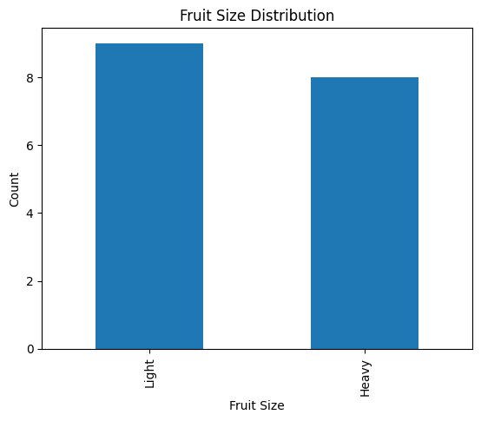
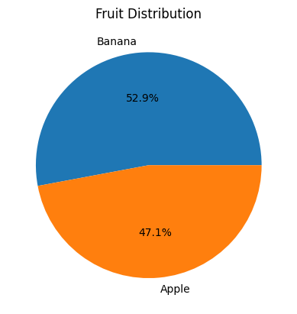
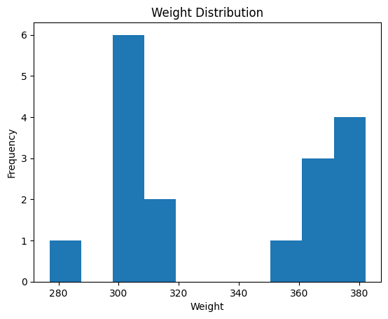
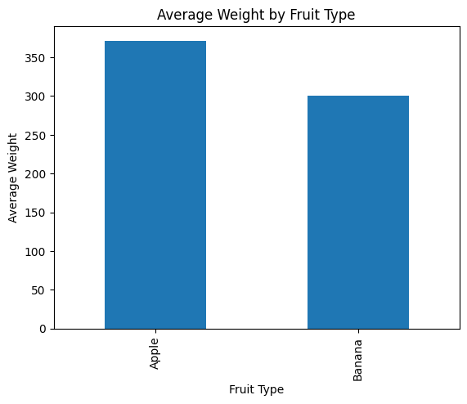
FRUIT DATASET KPI DASHBOARD
17
Total Fruits
8
Apples
9
Bananas
334.06 g
Avg Weight
Pie Chart
Fruit Distribution
Bar Chart
Fruit Size Distribution
Histogram
Weight Distribution
Bar Chart
Average Weight by Fruit Type

Slide 2
Business Insights
• Total fruits analysed: 17
• Apples: 8 | Bananas: 9
• Average Weight: 334.06 g
• Weight Range: 277 g – 382 g
• Weight and size are key classification features
Conclusion:
The dashboard provides meaningful KPI insights and visual analysis for fruit classification and decision-making.

